Slide 1
Malaria Vaccine Deterministic compartmental model in Dera Woreda

Slide 2
Introudction
Setting – Dera Woreda, South Gondar zone
Project quesiton.
What would be the impact of different vaccination scenarios on malaria burden in Dera woreda?

Slide 3
Approach
Initial SIR model with wout intervention
Estimating of selected parameters from data (optim)
Runnig the SIR model with optimal parameters – testing fitting
Use the model to run different vaccination scenarios

Slide 4
Parameters
b = 0.000465 # Birth rate of hum
m = 0.254144 # Recruitment rate of vectors
mu = 1/ (human_life_expectancy) # Natural human death rate
mu_v = 1/ (mosquito_lifespan)# Mortality rate of adult vectors
sigma = ? # Disease-induced death rate
beta_0 = 26 # bites per week
psi = ? #amplitude
gamma = 1/ (infectious_period) # Recovery rate
tau = 1/(126/7) # rate of waning immunity from recovered
tau
alpha_vh = # Transmission probability from vectors to hosts
alpha_hv = # Transmission probability from hosts to vectors
sigma - -0.641844026
alpha_hv - 0.008912758
alpha_vh - 0.007039342
psi - 0.336561225

Slide 5
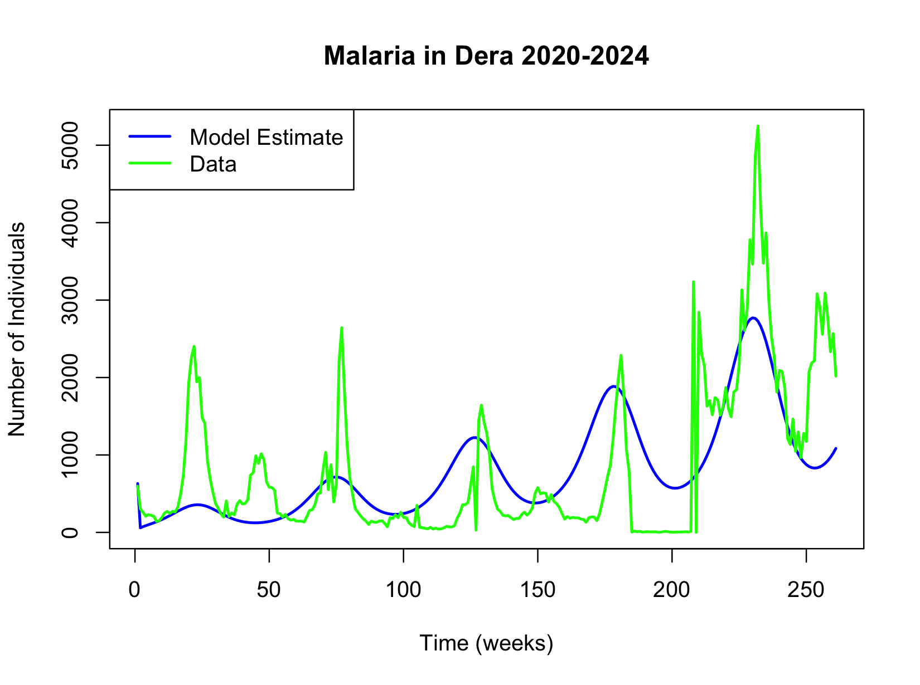
R-squared: 0.8746934

Slide 6
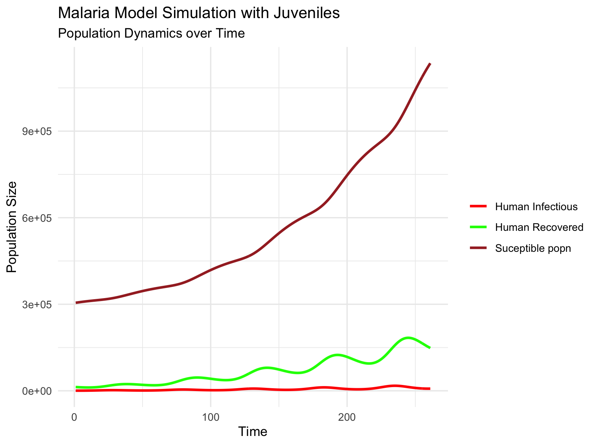

Slide 8
Incorporating vaccination scenarios

Slide 9
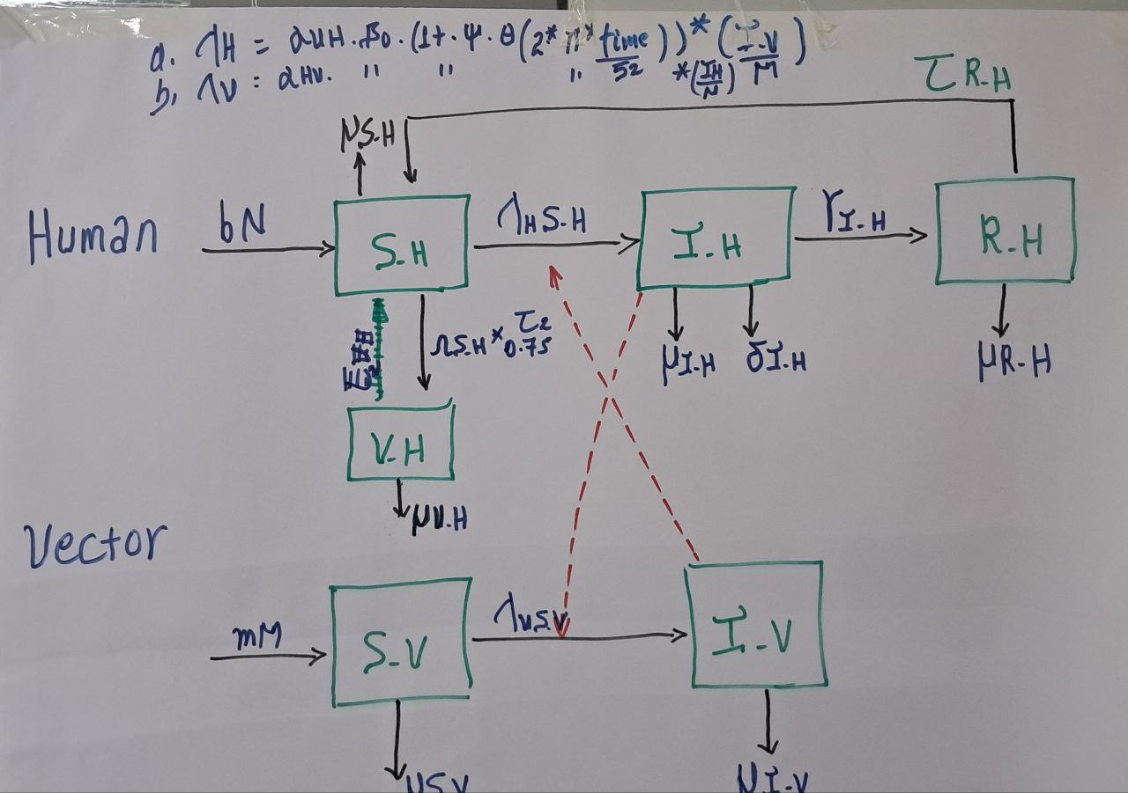

Slide 10
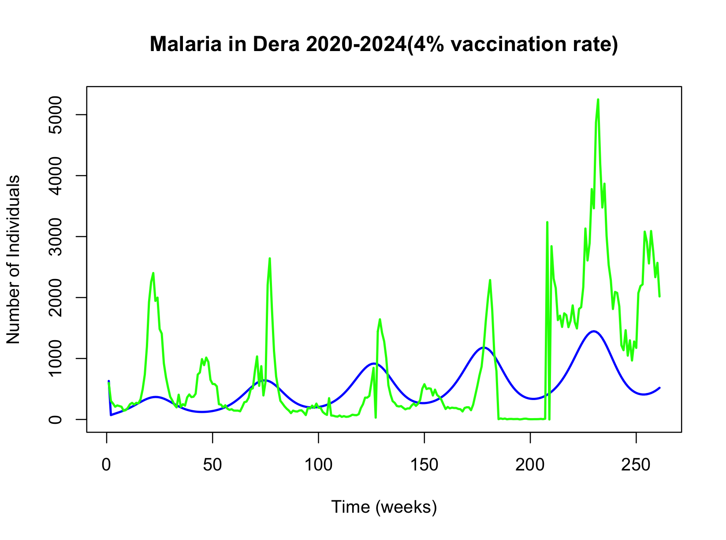

Slide 11
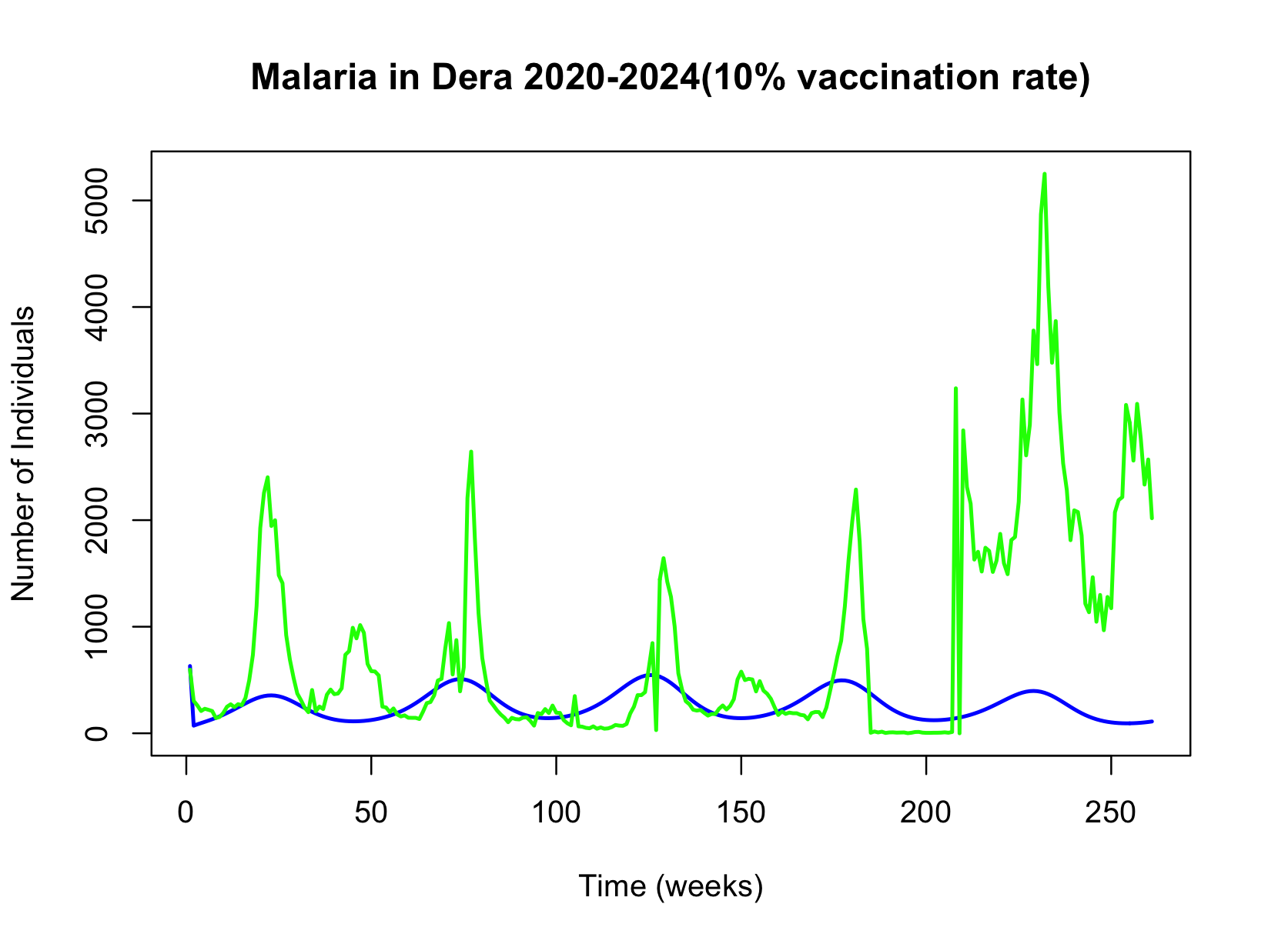

Slide 12
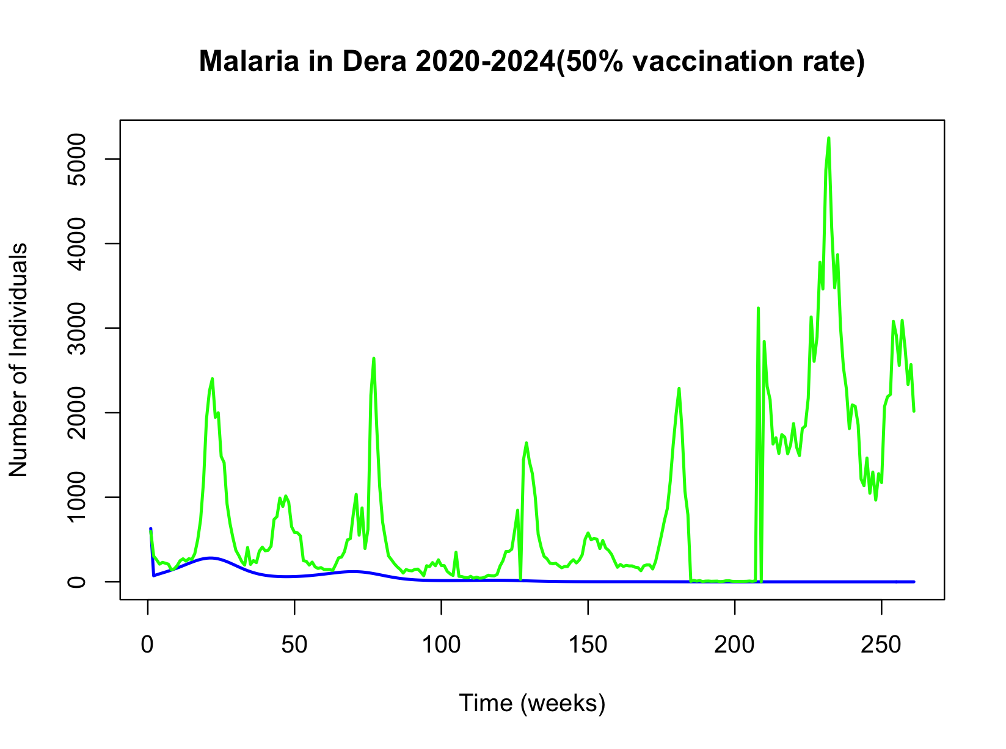

Slide 13
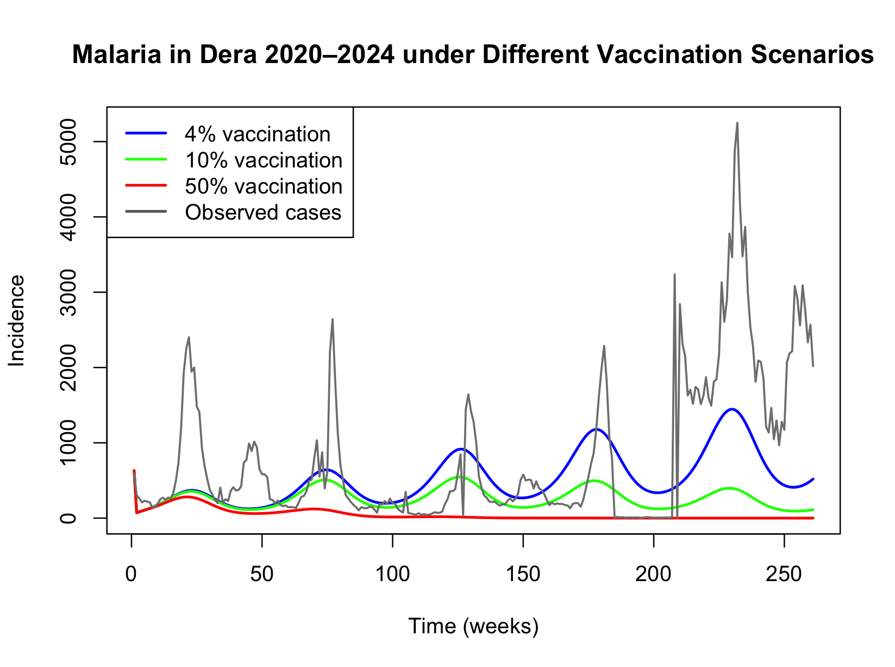
Precaution
No age group stratificaiton in the model
Vaccine immunity assumed to last the whole simulated(for those where it is effective (75%)

